Slide 1
Lecture 3
Optimizers 1: Invariances (and hyperparameters)
CS312
Tatsu H
Notes:
0

Slide 2
Logistics
Assignments and Quiz
A2 due Tuesday next week (~1.5 weeks)
Q2 at same time
Office hours and tutorials
Tutorial scheduling next week.
If you know you’ll drop, please do it before then!

Slide 3
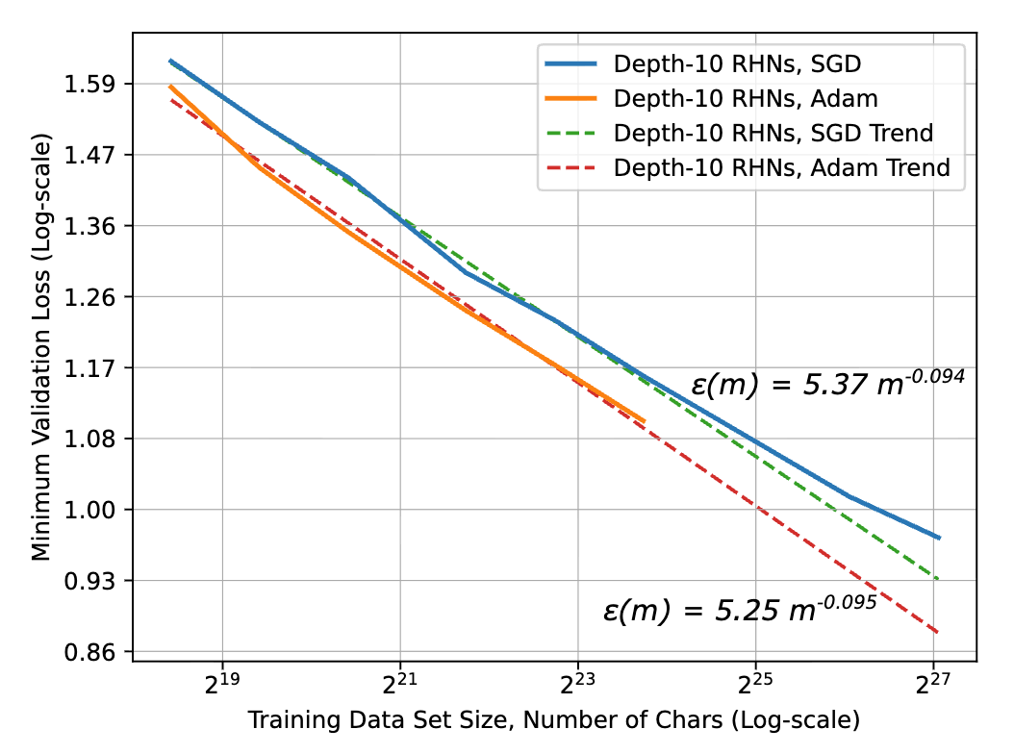
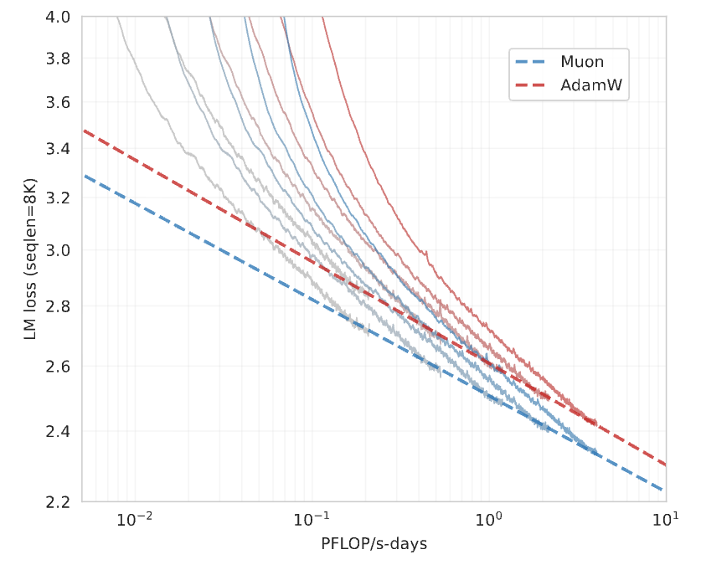
Optimization is central to training
Training is about making the loss go down, and optimizers are what make that happen
A general purpose, robust improvements in optimizers would be incredibly valuable

Slide 4
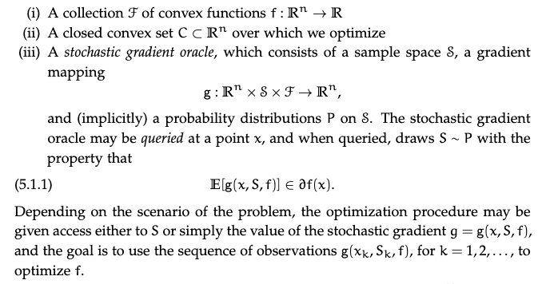
A classic view of first order optimization
Optimization under a ‘first order’ oracle (access to function value + gradient)
Many beautiful methods (mirror descent, frank wolfe, etc) that we will ignore in favor of
Ugly ol minibatch stochastic gradient descent
https://web.stanford.edu/~jduchi/PCMIConvex/Duchi16.pdf

Slide 5
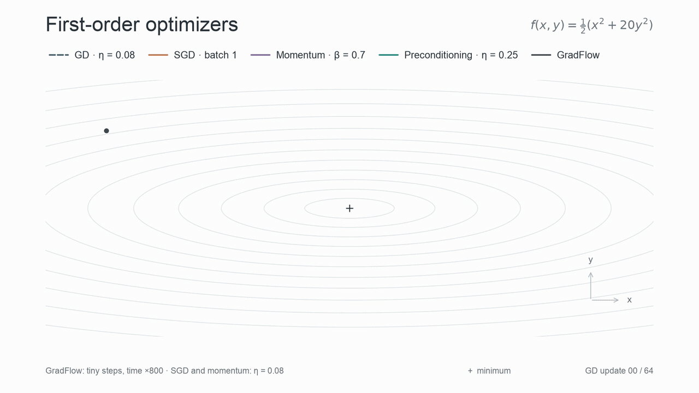
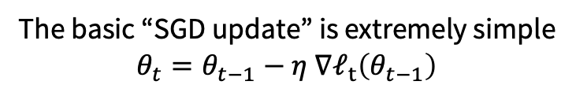
Different parts of an optimizer
The basic “SGD update” is extremely simple
$$θ_{t}=θ_{t−1}−η ∇ℓ_{t}\left(θ_{t−1}\right)$$
But, important variations!
Learning rate
Batching
Preconditioners
Momentum

Slide 6
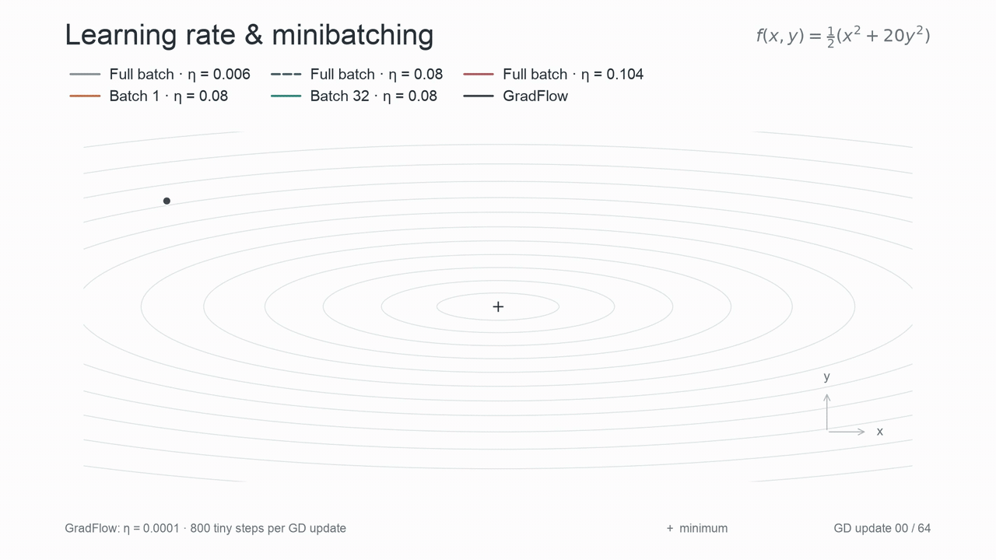
Learning rate and Batching
First choice:
Learning rates
Do we want to be in the ‘smooth’ regime?
Batch size
What’s the right tradeoff for stochasticity
(And how does it relate with scale?)

Slide 7
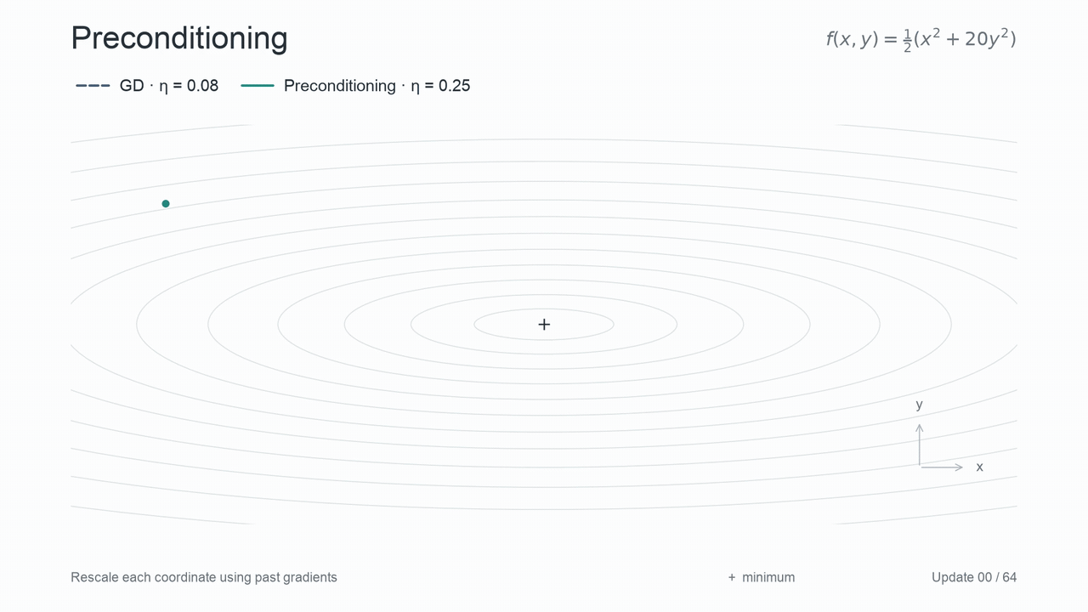
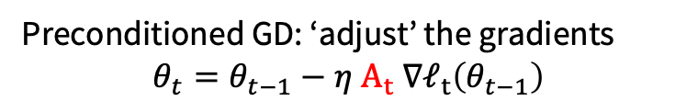
Preconditioning
Preconditioned GD: ‘adjust’ the gradients
$$θ_{t}=θ_{t−1}−η A_{t} ∇ℓ_{t}\left(θ_{t−1}\right)$$
The preconditioner is like a ‘change of coordinate’
Enables faster or slower LR per param
Allows us to ‘decorrelate’ parameters
Can be learned ‘on the go’* (basis of most modern optimizers)
Huge impact in practice
* Preconditioners must be PSD with bounded min/max eigenvalues

Slide 8
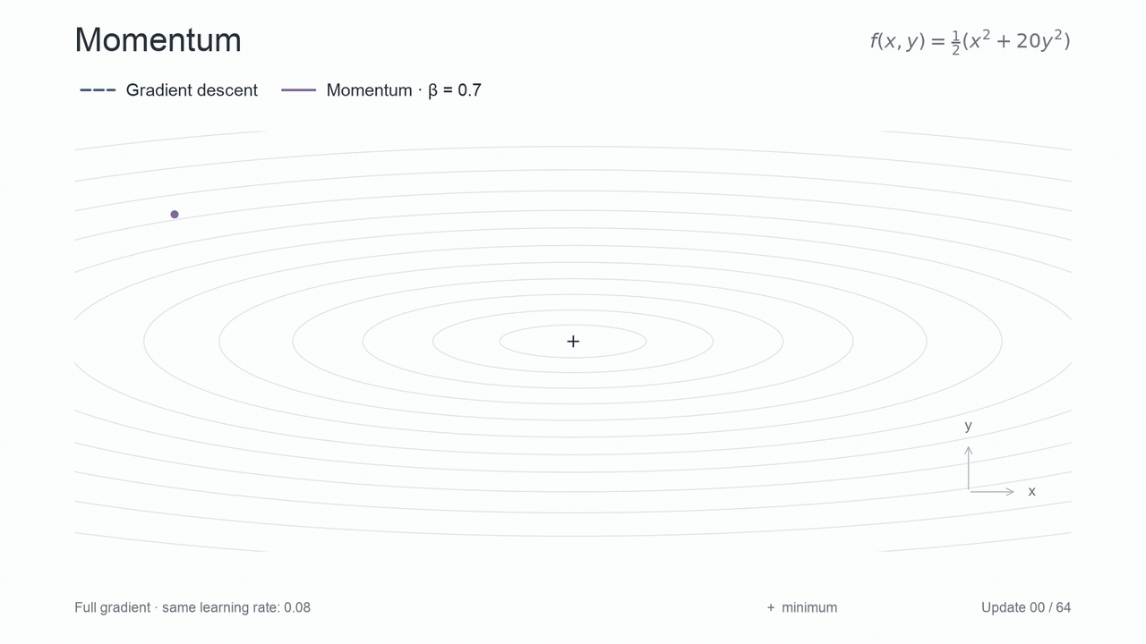
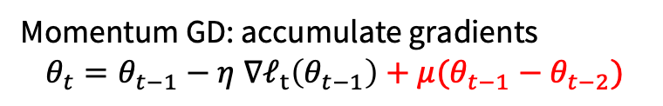
Momentum
Momentum GD: accumulate gradients
$$θ_{t}=θ_{t−1}−η ∇ℓ_{t}\left(θ_{t−1}\right)+μ(θ_{t−1}−θ_{t−2})$$
Momentum allows models to adapt to aligned gradients
Same gradients over many steps accelerate steps
Striking improvements in convergence rates (NAG)*
Also huge impact in practice
*From 1/T to 1/T^2 rate on smooth functions using Nesterov

Slide 9
A few (important) questions that we study
Progress in optimization is often careful treatment of these ideas.
We will cover a few useful (and tractable) questions in this space
How does batch interact with preconditioner/momentum? (Today, NQM)
How should we define or think about the LR? (Today, norms).
Per layer learning rates (and inits)? (next week, muP)
What preconditioner? (next week, Muon and friends)

Slide 10
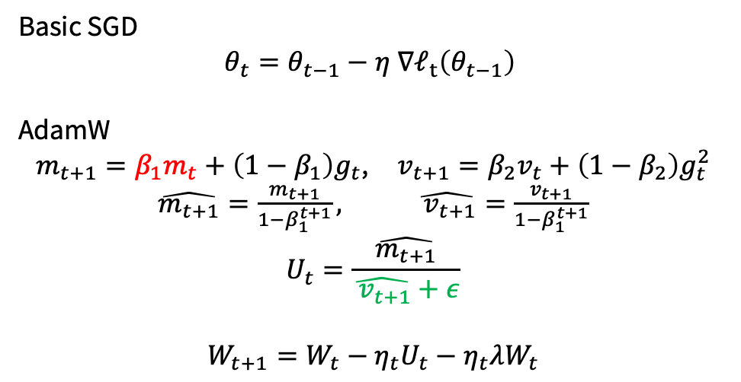
From classic first order to deep learning optimizers
Basic SGD
$$θ_{t}=θ_{t−1}−η ∇ℓ_{t}\left(θ_{t−1}\right)$$
AdamW
$m_{t+1}=β_{1}m_{t}+\left(1−β_{1}\right)g_{t}$, $v_{t+1}=β_{2}v_{t}+\left(1−β_{2}\right)g_{t}^{2}$
$\hat{m_{t+1}}=\frac{m_{t+1}}{1−β_{1}^{t+1}},$ $\hat{{ v}_{t+1}}=\frac{v_{t+1}}{1−β_{1}^{t+1}}$
$$U_{t}=\frac{\hat{m_{t+1}}}{\hat{{ v}_{t+1}}+ε}$$
$$W_{t+1}=W_{t}−η_{t}U_{t}−η_{t}λW_{t}$$
SGD with some carefully chosen momentum and preconditioning
The ‘W’ in AdamW refers to the fact that the decay is in the update, not the loss

Slide 11
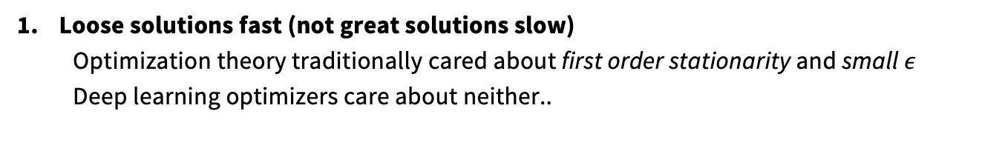
Why are ‘deep learning’ optimizers different?
Loose solutions fast (not great solutions slow)
Optimization theory traditionally cared about first order stationarity and small $ε$
Deep learning optimizers care about neither..
2. Doesn’t need to work for everything
We only care about fast optimization of deep neural networks. We can narrow the scope to very specific subsets of the set of objective functions

Slide 12
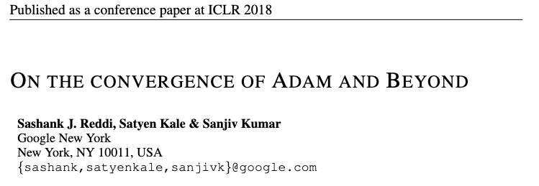
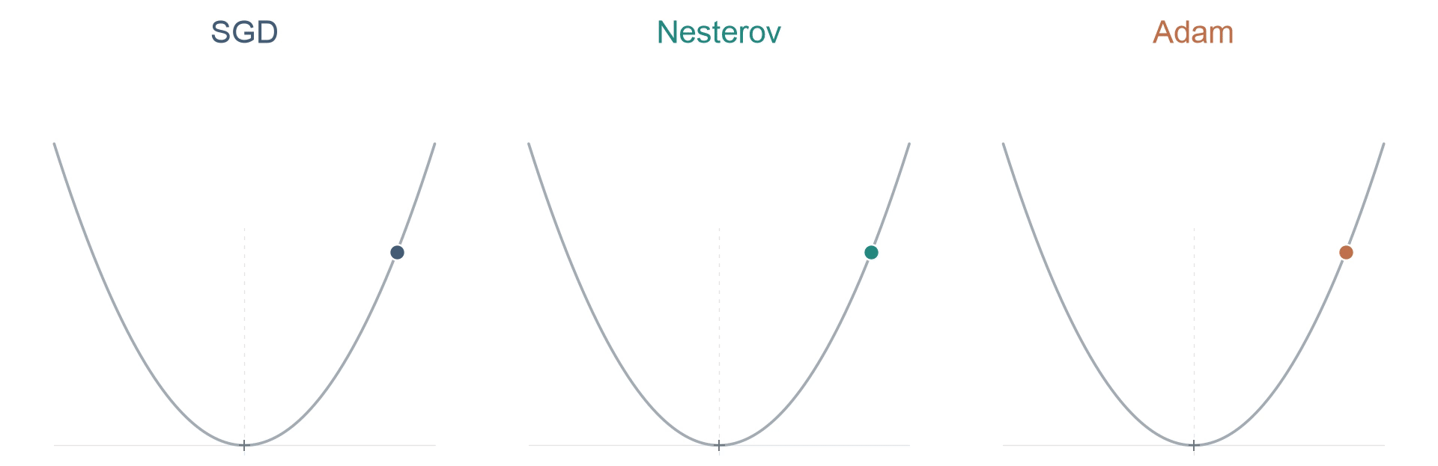
Does adam converge?
Well known that original proof was wrong (with explicit, non-convergent examples)
But we also don’t care! (we never converge our LLMs anyway)
From: https://arxiv.org/pdf/2210.02070 Bock and Weiss

Slide 13
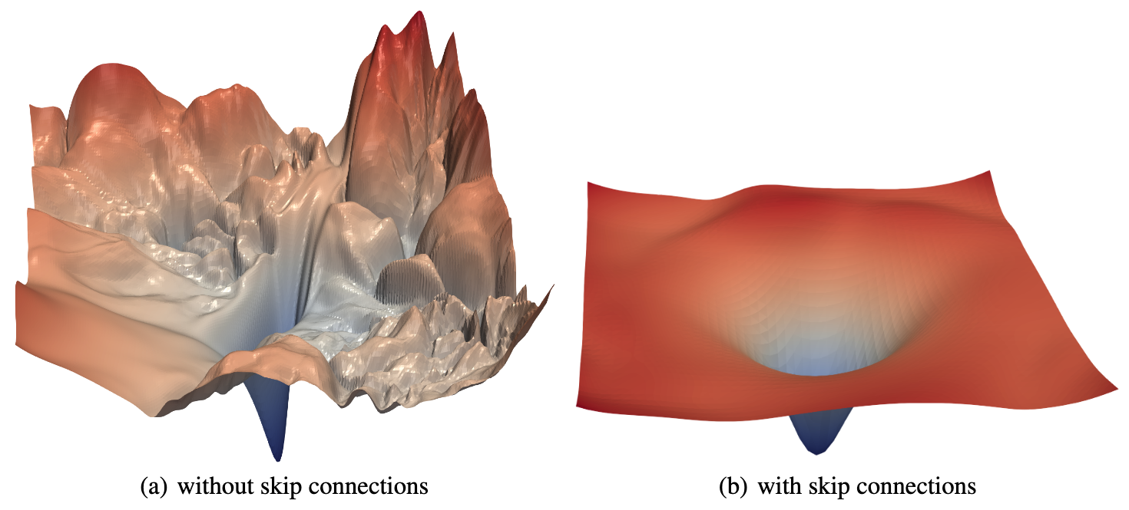
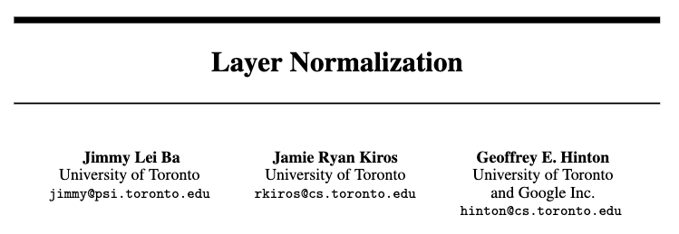
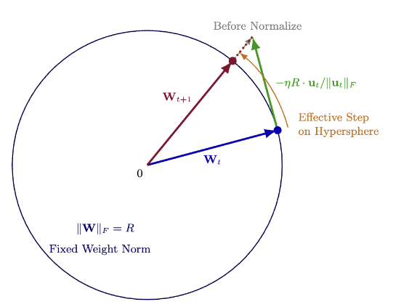
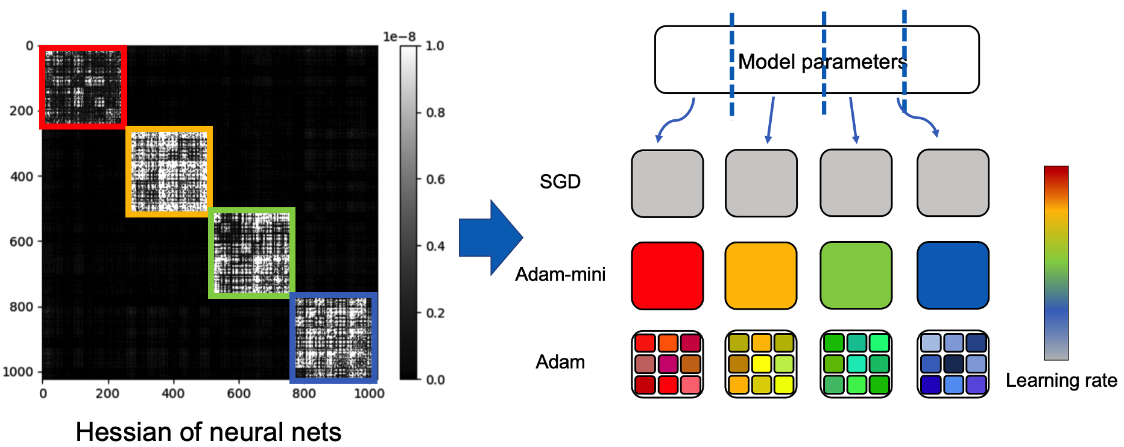
Implications for optimizer architecture codesign
Design architecture find easy to optimize losses
Design optimizer to accelerate training

Slide 14
Optimizers are complicated..
Rough mindset guide
Optimizers are not about ‘classic convex optimization math’
Get some ‘top down’ understanding of macro scale behaviors
Work backwards to reconcile ‘top down’ and ‘bottom up’ views
Things that should not work (Adam) do work well!
But also intuition from convex optimization can be useful
How do optimizers react to LR?
How do preconditioners and hessians interact?
How can we control one-step feature learning?

Slide 15
Lecture today
Part 1
Part 2
Convex intuitions (and their limits)
Optimizers and parameter norms

Slide 16
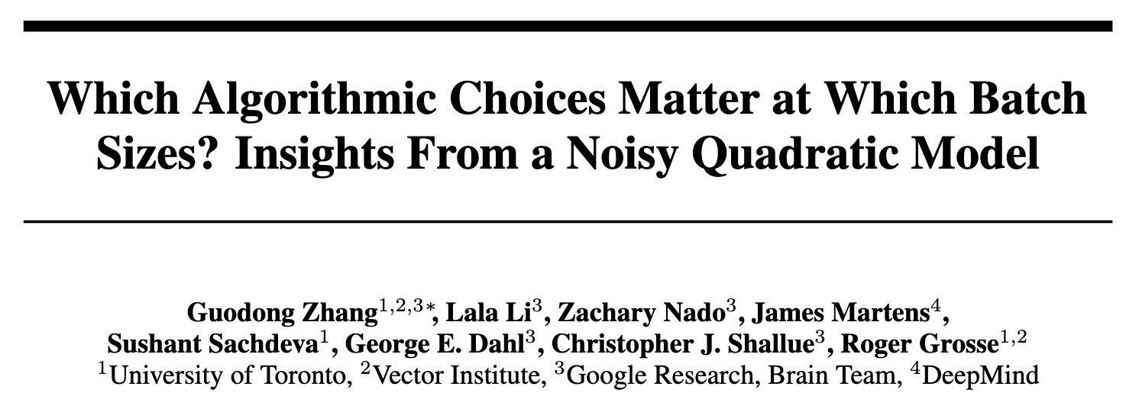
Part 1: The noisy quadratic model
How far can we push the ‘world is a quadratic’ view?
Advantages of the quadratic view
Many important quantities (i.e. optimal batch) are exactly solvable
In convex world, quadratics are very useful to think about (i.e. preconditioning)
We will go through a fairly influential paper that takes this approach

Slide 17
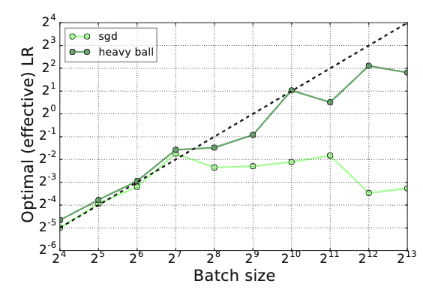
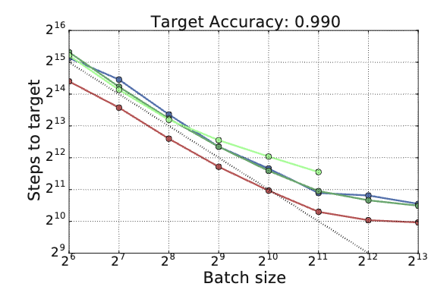
Why NQM?
Surprisingly accurate predictions
Batch vs LR on CIFAR
Number of steps needed
(i.e. ’critical batch’)
(dashed lines indicate theory predictions. theory predicts deviation from the line at large batch)

Slide 18
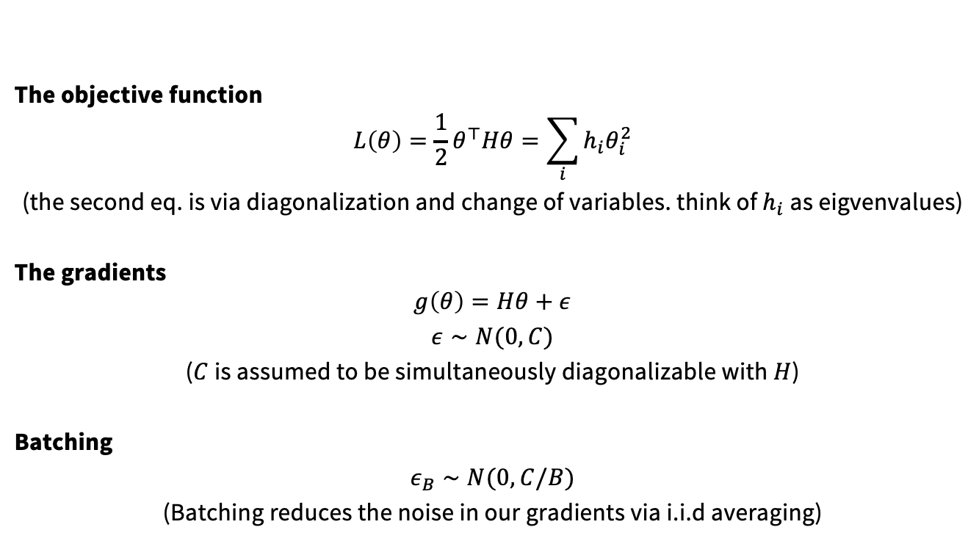
Defining the NQM
The objective function
$$L\left(θ\right)=\frac{1}{2}θ^{⊤}Hθ=\sum_{i}{h_{i}θ_{i}^{2}}$$
(the second eq. is via diagonalization and change of variables. think of $h_{i}$ as eigvenvalues)
The gradients
$$g\left(θ\right)=Hθ+ε$$
$ε∼N(0,C)$
($C$ is assumed to be simultaneously diagonalizable with $H$)
Batching
$ε_{B}∼N(0,C/B)$
(Batching reduces the noise in our gradients via i.i.d averaging)

Slide 19
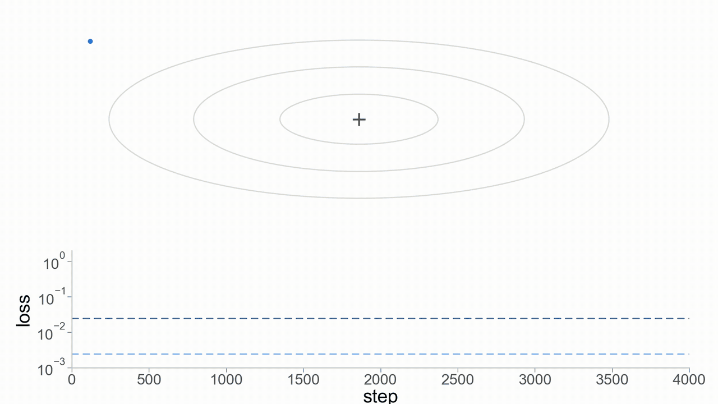
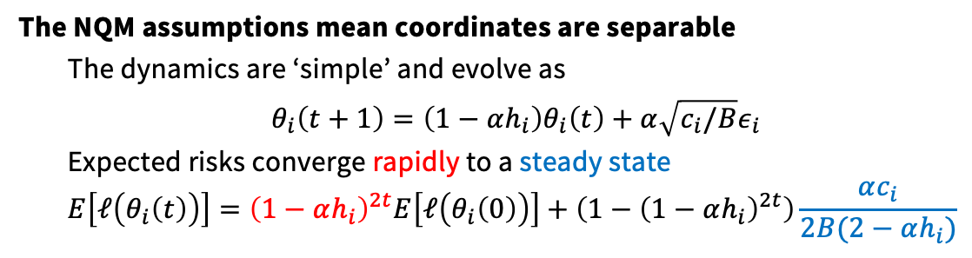
Dynamics under the NQM
The NQM assumptions mean coordinates are separable
The dynamics are ‘simple’ and evolve as
$θ_{i}\left(t+1\right)=\left(1−αh_{i}\right)θ_{i}\left(t\right)+α\sqrt{c_{i}/B}ε_{i}$
Expected risks converge rapidly to a steady state
$$E\left[ℓ\left(θ_{i}\left(t\right)\right)\right]={\left(1−αh_{i}\right)}^{2t}E\left[ℓ\left(θ_{i}\left(0\right)\right)\right]+\left(1−{\left(1−αh_{i}\right)}^{2t}\right)\frac{αc_{i}}{2B(2−αh_{i})}$$

Slide 20
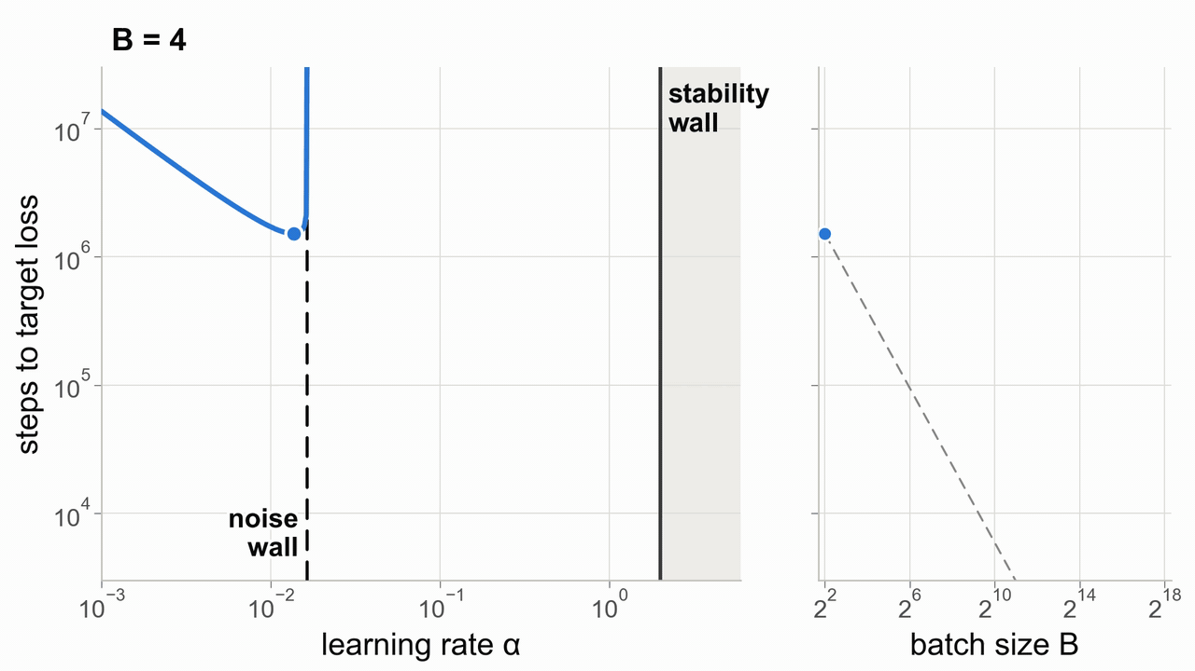
Batch size vs learning rate dynamics
NQM predicts that up to a certain point, learning rate should go up linearly with batch
But learning rate cannot go up forever! For a quadratic, 2/h is the max stable LR
After this point, batch shows rapidly diminishing returns (the ‘critical batch’)

Slide 21
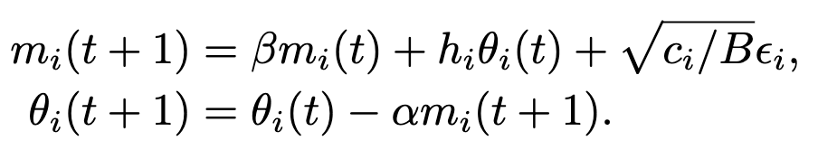
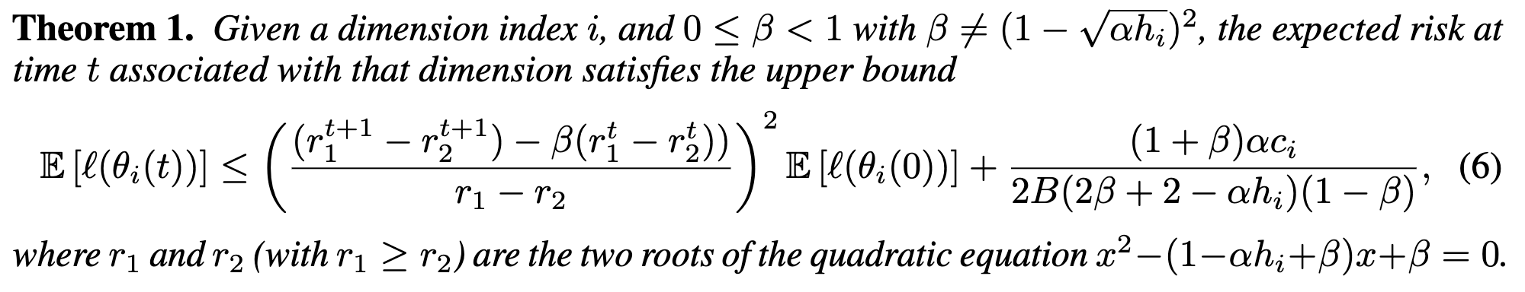
Implications for momentum
What happens to momentum SGD?
Now consider the momentum update,
We can derive the expected risk

Slide 22
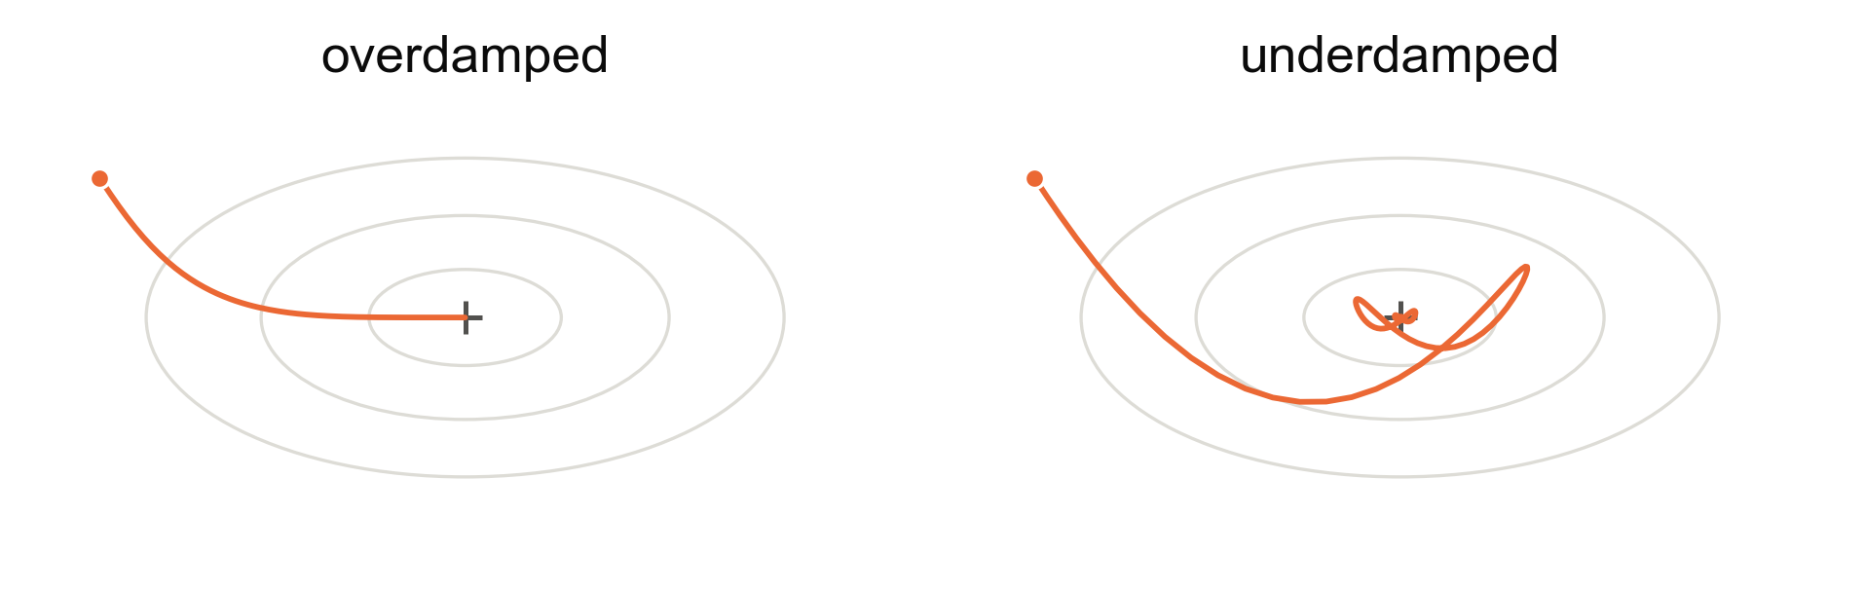
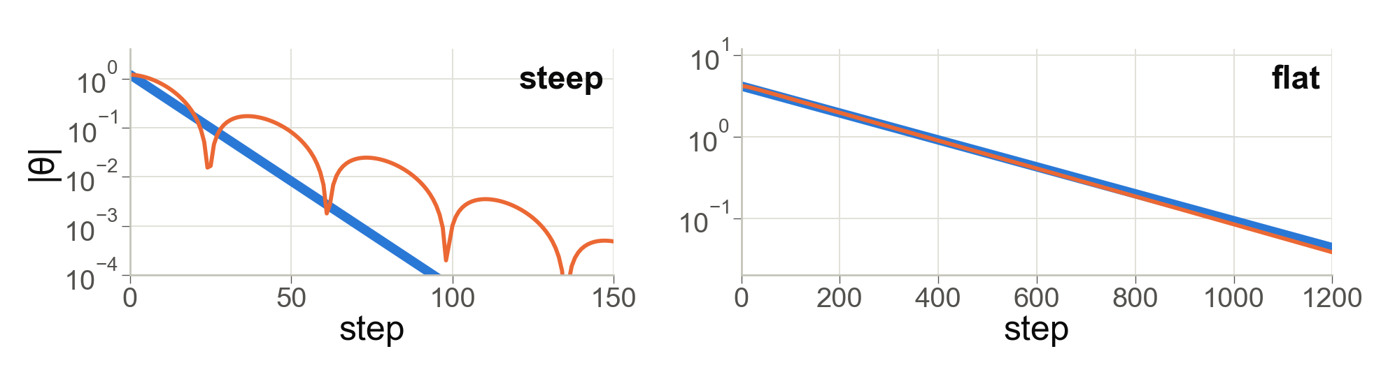
Understanding momentum dynamics in NQM
Overdamped vs Underdamped
Rate limiting by high curvature directions

Slide 23
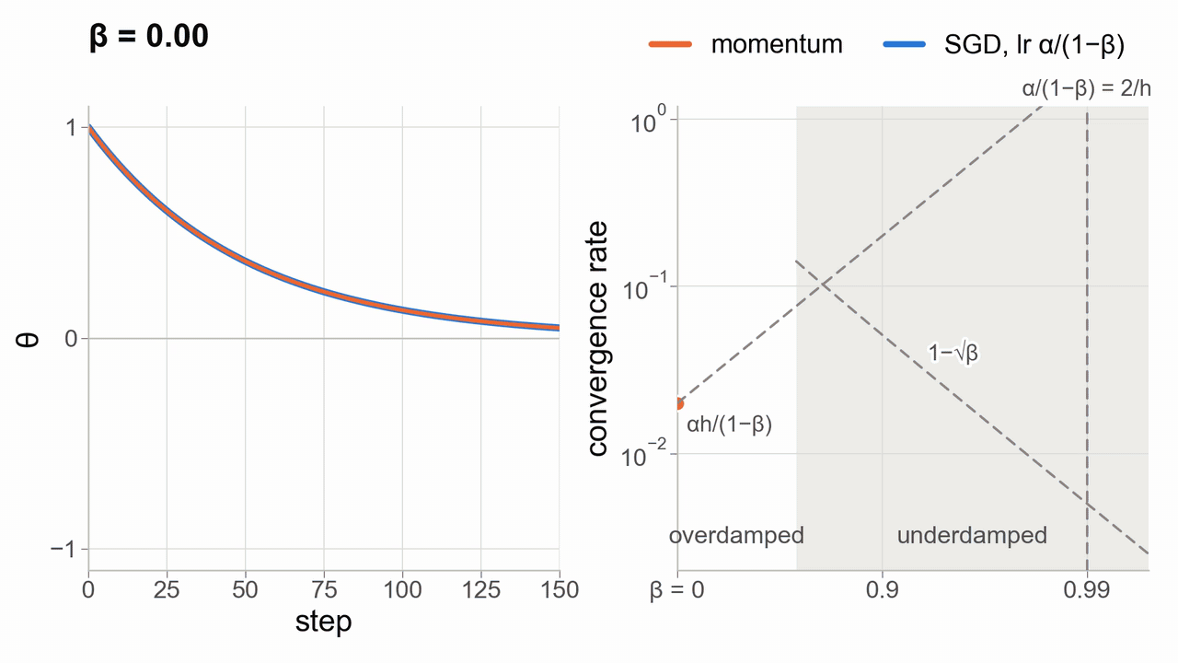
Damping, momentum, and convergence rates
How does over vs underdamped affect convergence relative to plain SGD?
Momentum has fastest convergence at the damping transition point
In the overdamped case, there exists a LR that matches momentum’s convergence rate
There is an upper limit to SGD LR due to the sharpness limit
(momentum acceleration allows optimizers to have higher effective LR than this limit)

Slide 24
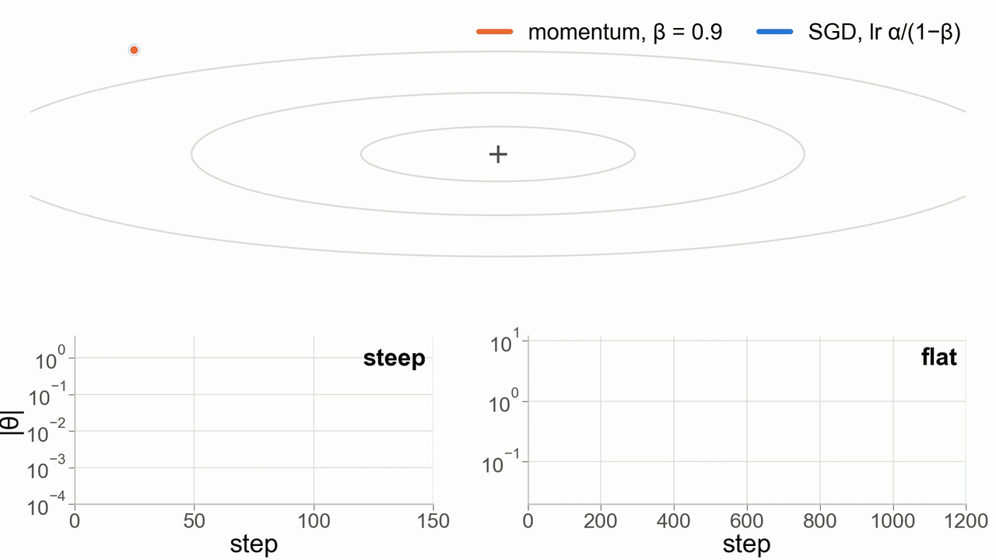
Overdamped dynamics control the convergence
The optimal momentum always has one overdamped coordinate
If SGD w/ effective step is convergent, this matches momentum long-run

Slide 25
Implications for momentum and batch
In the small batch case:
Irreducible error is large, and step size must be small to compensate.
Larger effective step size for momentum is counterproductive
In the large batch case:
Low irreducible error, large step size
Sufficiently large momentum reaches unattainable effective step sizes

Slide 26
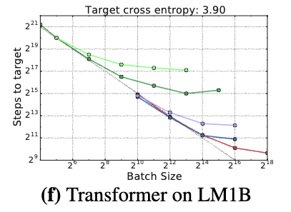
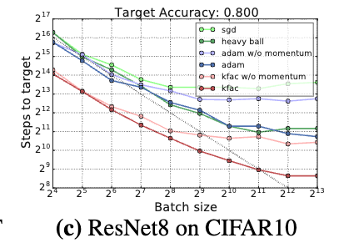
Empirical support for the large-batch-momentum view
At low batch sizes: no benefit to momentum
At large batch sizes: significant gains from momentum (heavy ball) as well as other tricks

Slide 27
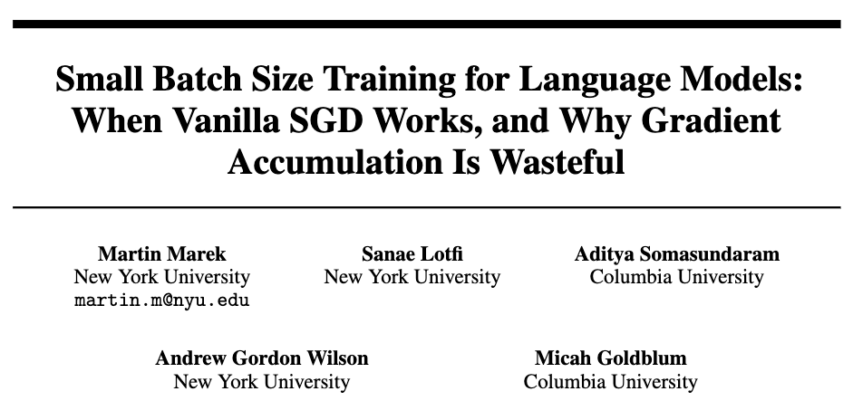
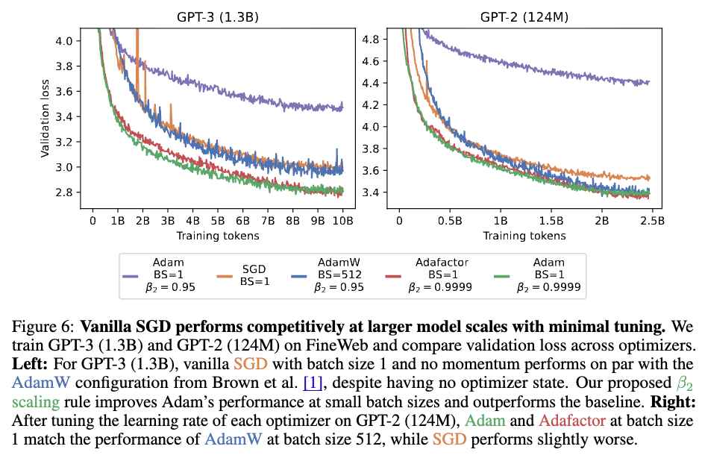
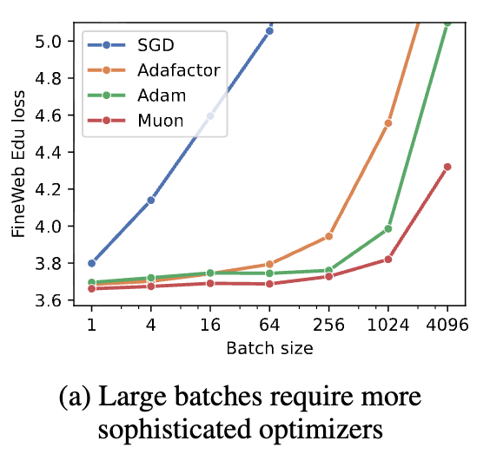
Other papers on momentum and batch size

Slide 28

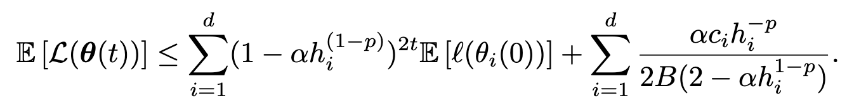
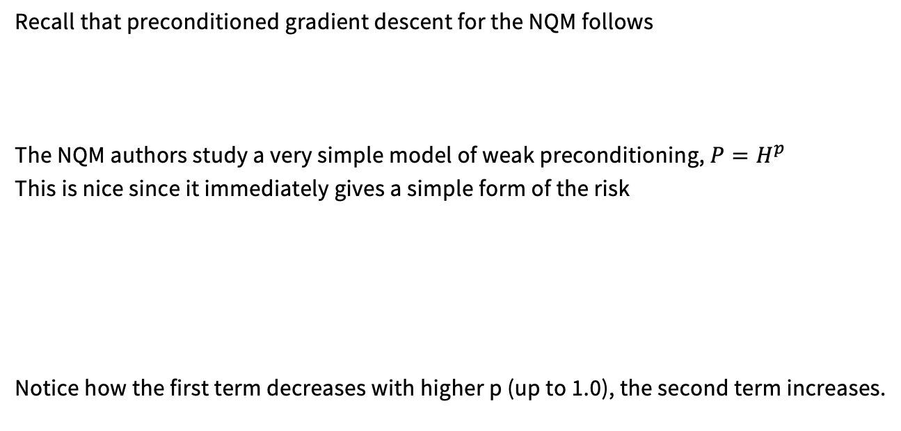
NQM and preconditioning
Recall that preconditioned gradient descent for the NQM follows
The NQM authors study a very simple model of weak preconditioning, $P=H^{p}$
This is nice since it immediately gives a simple form of the risk
Notice how the first term decreases with higher p (up to 1.0), the second term increases.

Slide 29
Comparisons on a range of optimizers
At low batch: no benefits to Adam vs others
At large batch sizes: significant gains from Adam (and KFAC)

Slide 30
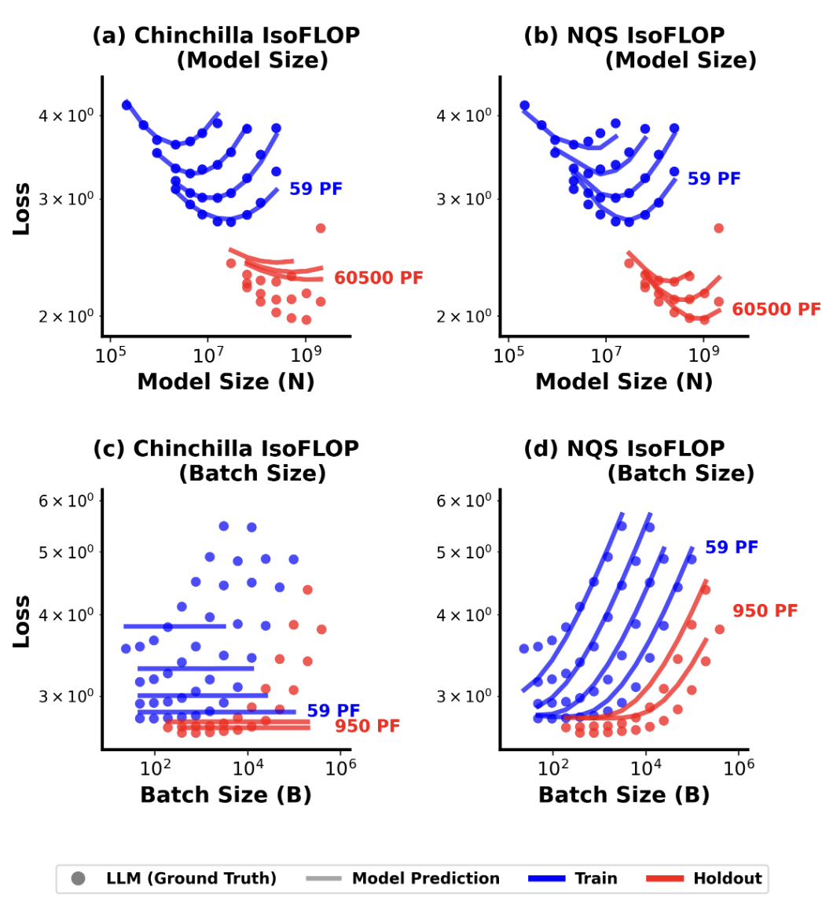
Other NQM stuff.
Recent extensions on using NQM style methods for scaling laws (li et al)

Slide 31
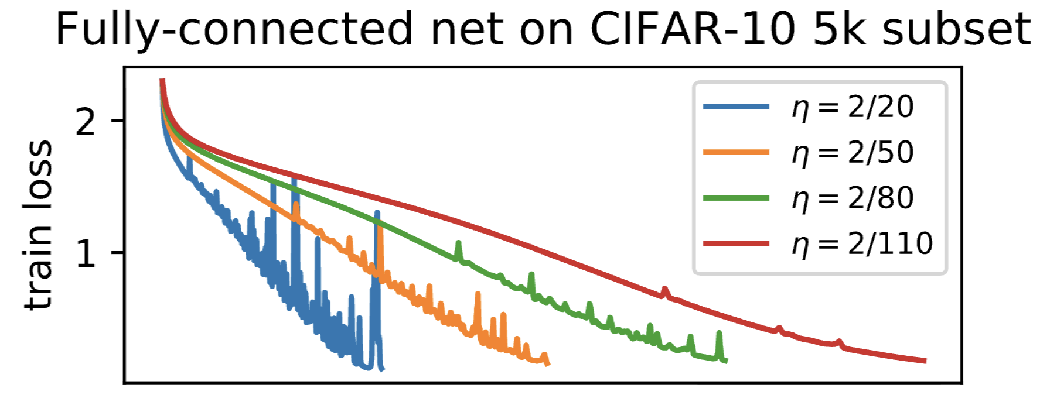
Limits of convex, quadratics
But… don’t trust quadratics blindly! Lots of deep learning is not like quadratics
Why do high learning rate, batch gradient descent trajectories show noise-like patterns?
We will cover many of these subtleties later..

Slide 32
Recap: NQM
The noisy quadratic model is very useful for thinking about optimization
Very convenient model for solving various properties analytically
Good rough intuition for when momentum or preconditioning helps
But, we know the world isn’t quadratic. Knowing the ‘right’ model and limits are key

Slide 33
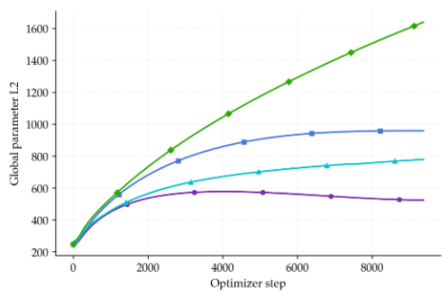
Part 2: Norms, weight decay, hyperball
In quiz 1, we’ve already seen some fun norm effects..
We know that norms (in our transformer model organism) tend to grow over time.
1. Why?
2. Who cares?

Slide 34
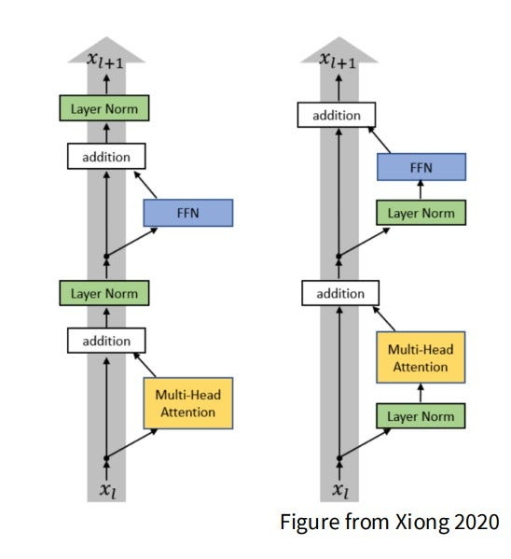
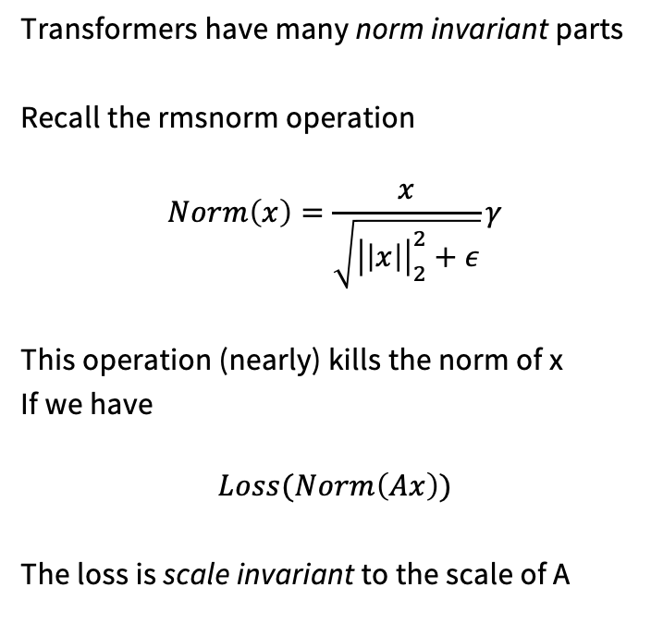
Preliminaries: Norm invariance in transformers
Transformers have many norm invariant parts
Recall the rmsnorm operation
$$Norm\left(x\right)=\frac{x}{\sqrt{{\left|\left|x\right|\right|}_{2}^{2}+ε}}γ$$
This operation (nearly) kills the norm of x
If we have
$$Loss(Norm\left(Ax\right))$$
The loss is scale invariant to the scale of A

Slide 35
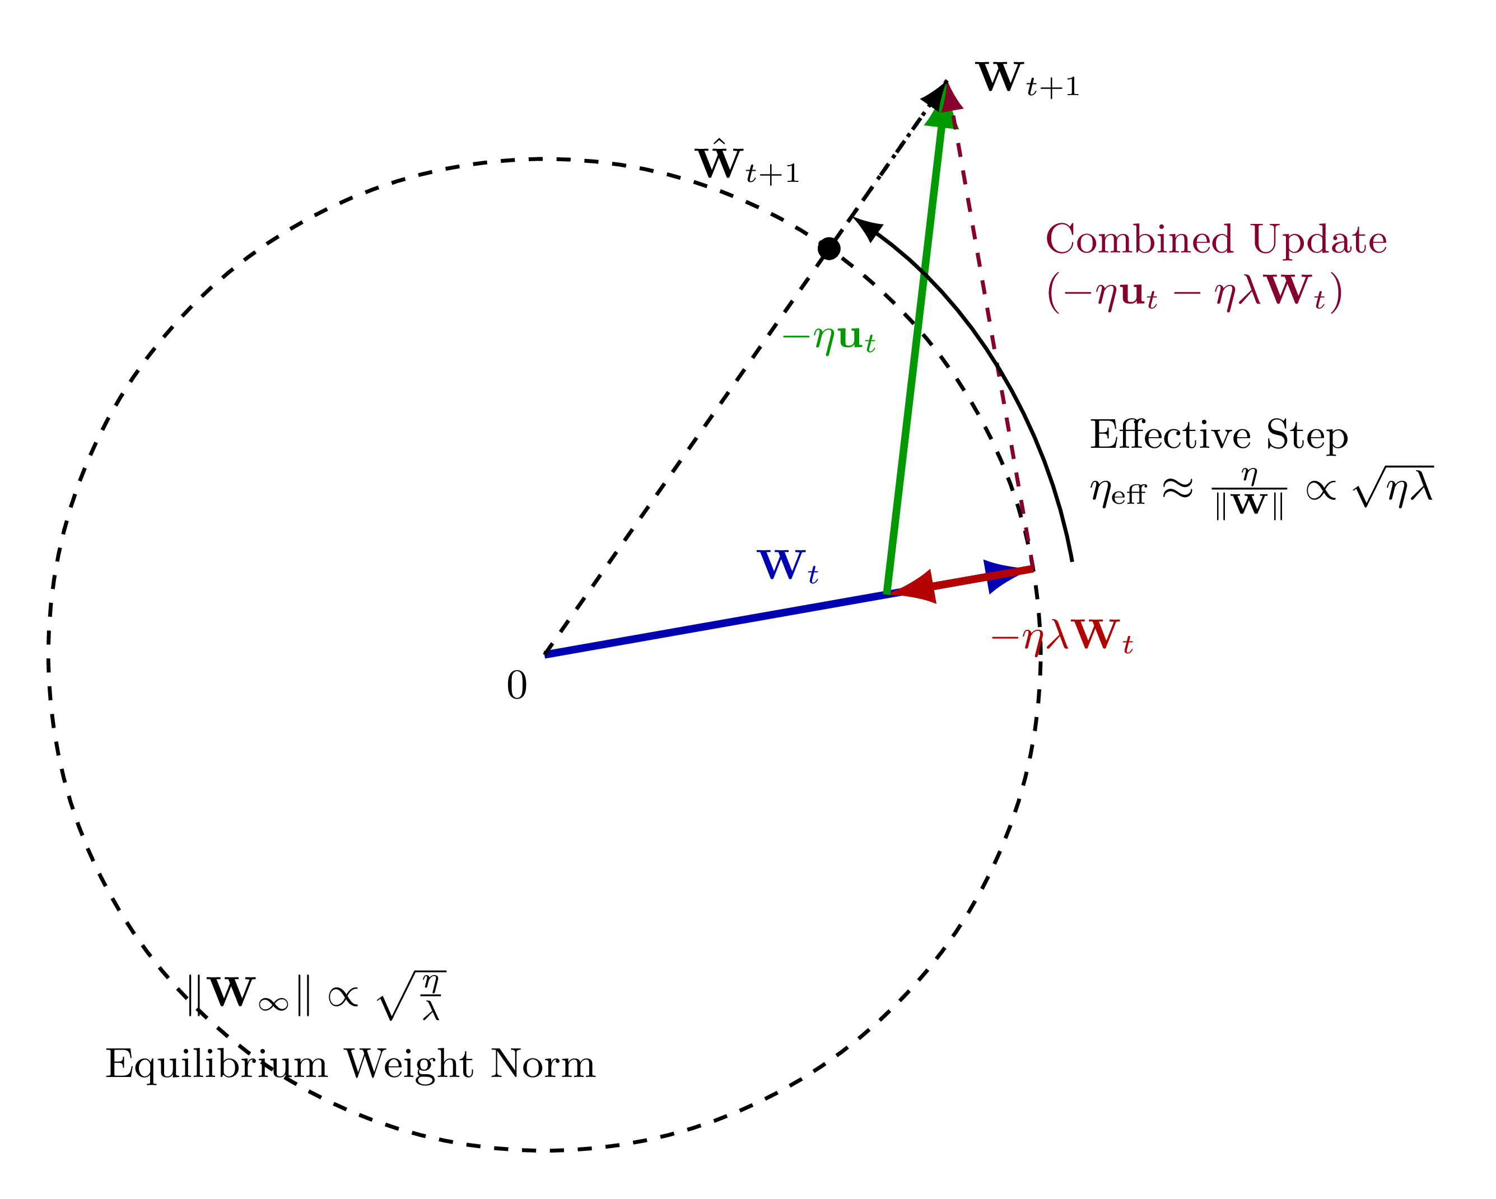
Norm drift in norm invariant models
For norm invariant weights, we might expect the following..
Gradients are tangent to the current norm (or approx. for approx. invariant)
This increases the norm, with higher LR increasing the norm more
Weight decay pulls it back, with a dynamic equilibrium
https://whenwen.github.io/wd_blog/public/weight-decay-part-2.html

Slide 36
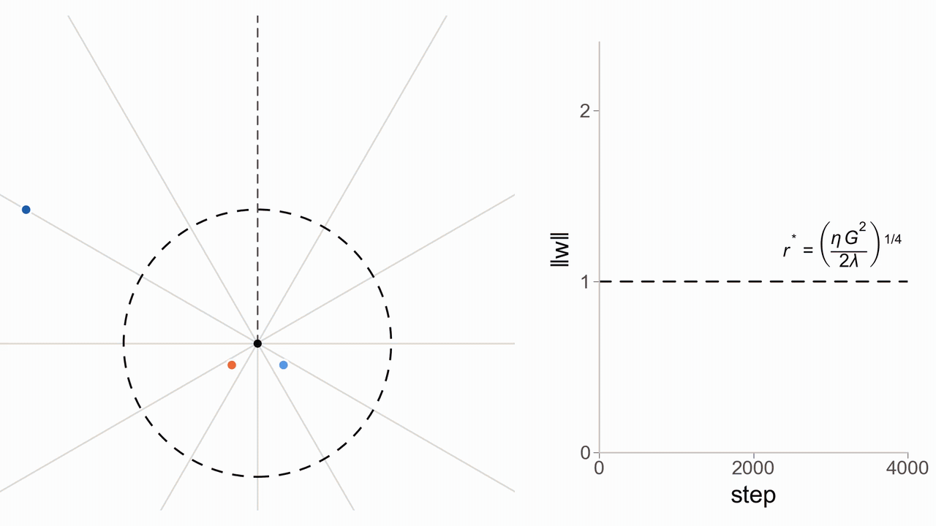
Norm drift in the toy case
We can see this in a simple, 2D norm invariant loss

Slide 37
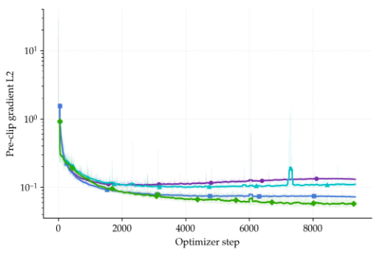
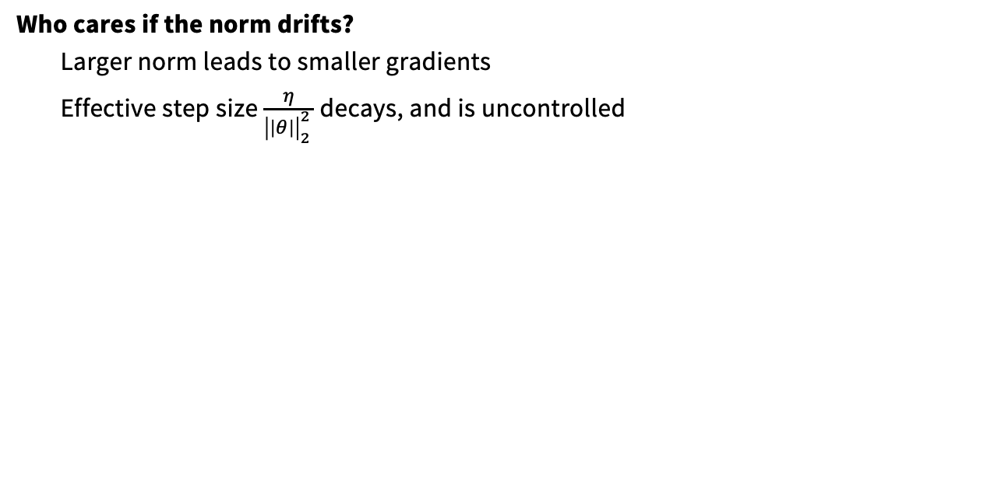
Do we care if the norm drifts?
Who cares if the norm drifts?
Larger norm leads to smaller gradients
Effective step size $\frac{η}{{\left|\left|θ\right|\right|}_{2}^{2 }}$ decays, and is uncontrolled
From: Guodong et al https://openreview.net/pdf?id=B1lz-3Rct7

Slide 38
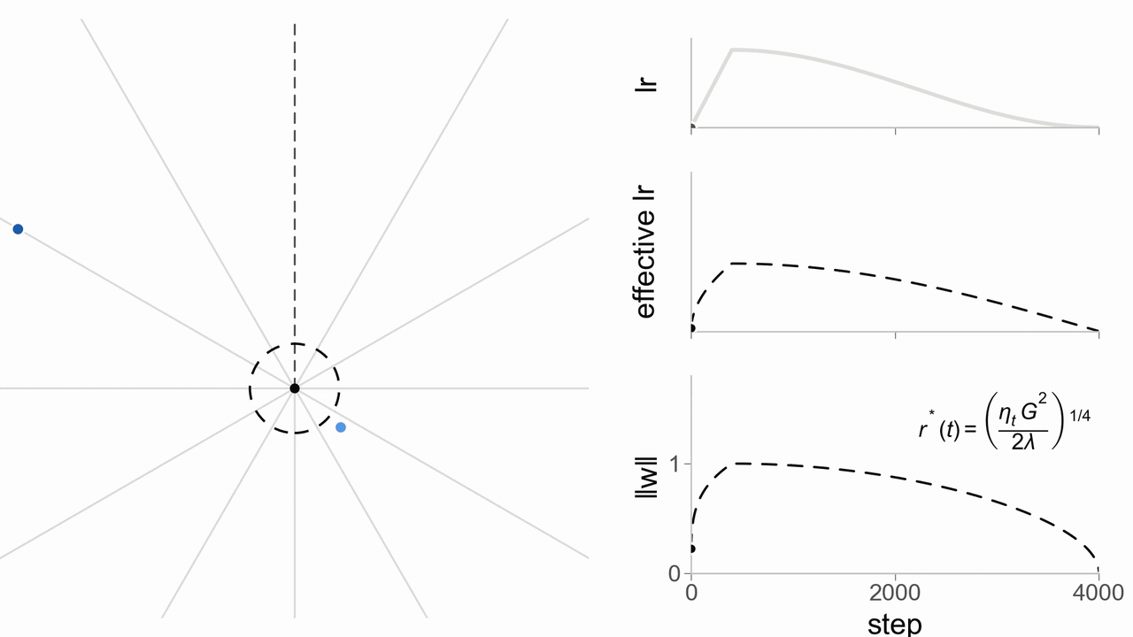
Back to our toy case
How does the ‘effective’ learning rate change in our toy example?

Slide 39
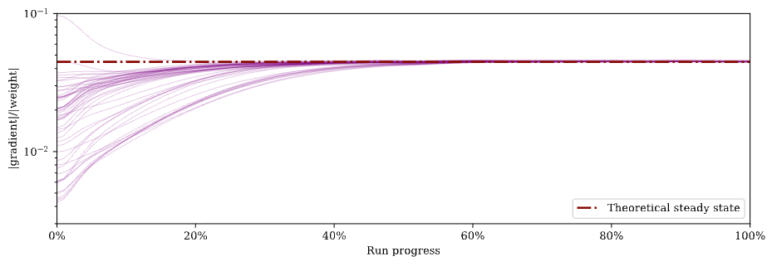
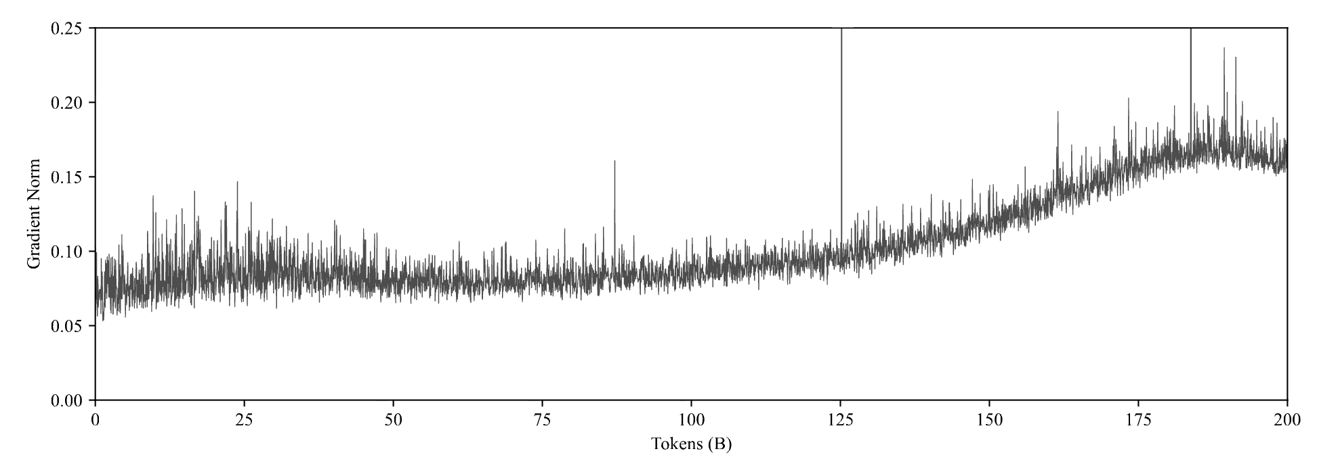

Revisiting weight decay
Other views: Defazio 2025
Ratio of gradient to weight should equilibrate to $Θ\left(\sqrt{\frac{2λ}{α}}\right)$ .
Vary weight decay over time as $λ_{t}=\frac{λα_{t}}{α_{max}}$ to keep the ratio constant

Slide 40



Evidence for this view
LR and WD jointly control norm
WD improves loss in one
pass SGD
WD manipulates effective LR
van Laarhoven 2017
Guodong et al 2019
D’Angelo et al 2024
N.b. Weight decay has other impacts, like regularizing the jacobian norm

Slide 41

Designing a new optimizer
What might we do to deal with this annoying weight decay and LR coupling?
Sounds a bit silly… but is it?

Slide 42

Subtleties
We don’t literally want a norm-constrained model..
The output norm
= confidence
Norm the norm?
Embedding norms
useful?
Normalize the ‘internal’ weights (MLP and attention weights)

Slide 43



Hyperball
We can ‘wrap’ any optimizer with a norm-invariance aware wrapper
Project our updates to be unit norm (line 3)
Update, scaling up to norm R and using step size eta
Project the resulting parameter back to norm R
As a reasonable default, set $R={\left|\left|W_{0}\right|\right|}_{F}$

Slide 44




Many successful related ideas,
Columnwise weight norm
Activation norm
Reparametrization
Gradient descent on a Stiefel manifold
(vs spherical)
Ball projection (like hyperball)

Slide 45

How does it work?
Pretty good! Lower loss and norm control by construction [From Wen et al ‘26]

Slide 46

Hyperparameter transfer
Hyperball might also improve hyperparameter transfer
(You will try this in your assignment)

Slide 47


Some corroborating evidence
Experiments roughly line up with hyperball (plus some new stuff)
Also interesting evidence that frobenius norm (sphere projection) is the best norm

Slide 48
Optimizer architecture codesign
Momentum and preconditioner design
Optimization dynamics
Architecture and model constraints
Unit norm to control ‘effective LR’

Slide 49
Recap: Norms
The quiz question we gave you has suprising implications!
In one-pass regimes, weight decay controls ‘effective LR’
Having the effective LR drift uncontrollably is often not ideal
Precise control over the norms (and therefore LR) can be very useful

Slide 50

Conclusion
Optimization (and deep learning) is complicated!
Theory intuitions can be useful! NQM is a workhorse for training dynamics
Mental models (i.e. quadratics) have limited scope. Knowing when they apply is subtle
From Roger Grosse’s Toronto lectures on deep learning training dynamics..

